Slide 1
achieve, banish, defeated, insurmountable, come up against, dream, perseverance, inspiration, initially, rejected

Slide 2
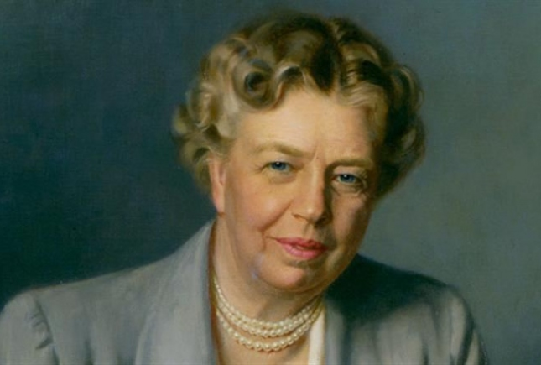
The future belongs to those who believe in their dreams.
Eleanor Roosevelt, American politician

Slide 3
I see myself….
I might try and….
I’m thinking of….
If I can, I’ll….
What I’d really like to ….
I’m really dreaming….
I’ve always dreamed of…
I desperately want to….
I long to become…..

